Slide 1

GOOD PRECTICES/ INITIATIVES
“QUALITY WORK”
PRESENTATION

Slide 2


Quality Theme

Slide 3
Quality Objectives – F.Y. 2018
OBJECTIVES | STRATEGY | TARGETS
Maintain an effective quality management system in compliance with ISO 9001 standards (Corporate level) | Maintain ISO 9001 Certificate | Zero Major Non-Conformity
Enhance customer satisfaction | Monitor and track the Customer feedback/ complaint process to ensure issues raised by Customers are properly addressed and closed out within time frame. Conduct customer satisfaction survey at all projects at 50% and 100% of project completion. | Outstanding Feedback/complaints rate: 0% Client Satisfaction Index > 80%
Consistently implement the quality management systems across the business. | Implement the internal audit process (QA) to verify the compliance of project management system against corporate requirements. Monitor the status of closing out audit observations to ensure corrective actions are taken to rectify identified issues in timely manner. | Level 2 Quality Audit Score > 85% Outstanding Observations Rate < 25%
Efficiently manage project quality performance to ensure deliver high quality project to our Clients. | Fully develop construction WMS and ITP’s to ensure execution works meet the Industrial Standards and contractual specifications. Conduct regular Quality Control Audits on operations activities including Subcontractor works and monitor the status of closing out identified Non-Conformities. Control Subcontractors and suppliers performance | Inspection rate: 100% as per ITP Outstanding NCR’s Rate < 25% Vendor Pre-qualification Rate: 100% (for major suppliers and subcontractors) Vendor performance evaluation Rate: 100% (for major suppliers and subcontractors)
Enforce the awareness of quality concept in the business. | Frequently conduct quality induction and tool box talks for project staff | Quality Management systems Induction Rate : 100% Quality Training: 2 sections/ month Quality Walk: 1/ month

Slide 4
Duties & Responsibilities of Quality Team
Quality Manager –
To prepare QP,ITP,s as per specifications.
To Ensure the Implementation of SBT Quality Management system at Project site .
QA-QC/Lab Engineers/Supervisors –
To Ensure that work is being carried out as per WMS.
Inspection of the work ,conducting Lab tests as per ITP.
Inspection & testing of incoming materials at site /plant.
Inspection of site activities, Subcontractor’s work, to issue OFI to avoid poor quality/defective work, NCRs for Non conforming works & follow up for their closure.
Maintaining quality records.
Submit Weekly Reports / Monthly Reports.
Ensure routine Calibration of measuring equipment's.

Slide 5
Corporate Procedures-Quality
SBT-QAM-PR-001 -Management Review Meeting
This procedure sets out the process for scheduling and conducting regular management reviews of the company’s management systems to ensure their continuing suitability adequacy and effectiveness.
Management Reviews shall be held at the following intervals:
Meetings at Corporate level to review the functionality of the Corporate Integrated Management System – at least once in each financial year.
Meetings at Project Levels to review the functionality of the Project Integrated Management System – at least twice in each financial year. Quality Monthly Report shall be prepared and forwarded to HO for records.

Slide 6
Corporate Procedures-Quality (cont..)
SBT-QAM-PR-002 -Procedures
This procedure describes the Company’s guidelines on the preparation of procedures to ensure that system procedures are consistent with the requirements of Quality Standards as well as Company policies.
At Corporate Level, the Managing Director and Business Partner – HSSEQS are responsible to ensure Corporate procedures are in compliance with SBT Management system.
At Project Level, Project Management Team and Project Quality Representative are responsible to ensure that SBT Procedures are communicated, implemented and maintained.
Corporate Systems Representative is responsible to ensure latest versions of SBT Procedures and SOP’s are uploaded into the company Server.

Slide 7
Corporate Procedures-Quality (cont..)
SBT-QAM-PR-003 –Project Management System
This procedure describes the Company’s requirements for the preparation of Project Management system documentation including Project Management Plan in order to ensure that project documents are in line with Management System.

Slide 8
Corporate Procedures-Quality (cont..)
SBT-QAM-PR-004 –Quality Assurance Audit
This procedure describes the Company’s guidelines on quality assurance audits at all business levels. These audits are essential for the Company to:
Assess and monitor business performance.
Ensure the system is properly implemented in compliance with ISO 9001 standard, contractual and regulatory requirements.
Ensure the system can be continually improved.procedures are consistent with the requirements of Quality Standards as well as Company policies.
The Frequency of Audit is as below:
Level I audit – Conducted by Project Quality Manager on Quarterly Basis.
Level II Audit – Conducted by Business Unit Team once in a 6 months.
Level III Audit – Conducted by Third Party for Certification Purpose.
Quality Walk- Conducted by Project Quality Manager on Monthly Basis.

Slide 9
Corporate Procedures-Quality (cont..)
SBT-QAM-PR-005 –Internal Non Conformity
This procedure describes the Company’s guidelines on managing internal non-conforming items or services. The purpose of this procedure is to:
Identify, document and manage items that do not meet the agreed requirements and prevent their inadvertent use.
Identify improvement areas by recording and analyzing causes of not meeting the agreed requirements.-OFI is issued
Control the quality internal failure cost i.e. the cost of defects and nonconformities to enable actions to be taken to reduce the project cost..

Slide 10
Corporate Procedures-Quality (cont..)
SBT-QAM-PR-006 –Control of Quality Cost
This procedure describes the Company’s guidelines on project reporting of quality internal failure cost i.e. the cost of defects and nonconformities to enable actions to be taken to reduce the project cost.
The Operations team and accounting department is responsible to collect the cost related to non-conformance, allocate these costs to the agreed activities and provide the data to quality Department for quality cost assessment.
The quality management is responsible to analyze the quality related costs and take appropriate controlling actions.

Slide 11
Corporate Procedures-Quality (cont..)
SBT-QAM-PR-007 –Quality Training
This procedure describes the Company’s guidelines on the SBT Quality Training process. The purpose of quality training is to give :
An Overview of ISO 9001 requirements.
Quality Policy, Objective and Performance
Customer Satisfaction
Non-conformance Report and Opportunity For Improvement
Document Control process
Continual Improvement and Innovation
Project Quality Manager is responsible to develop and implement Quality Control Training at planned intervals.
At project level, Project Quality Manager shall liaison with HR Department to develop the Training Need analysis and Training matrix to implement the Quality Control Trainings for the Current Year .

Slide 12
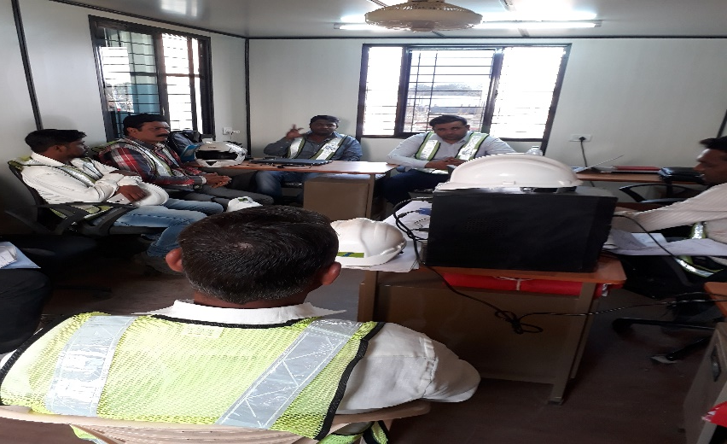
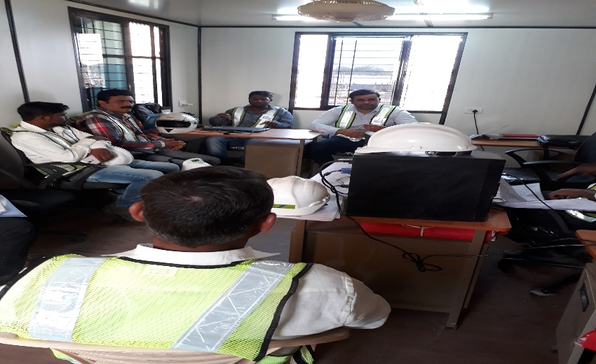
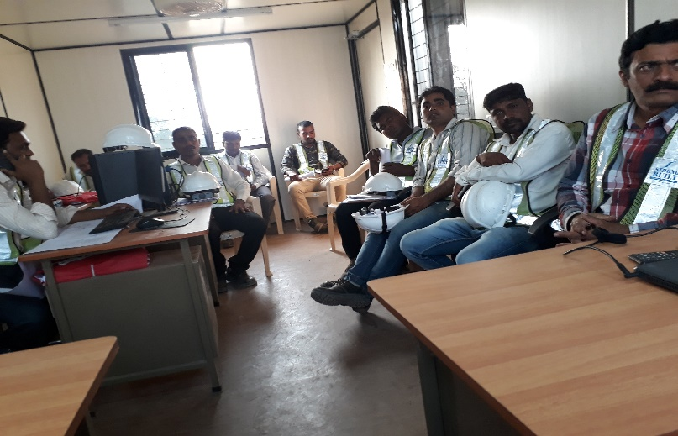
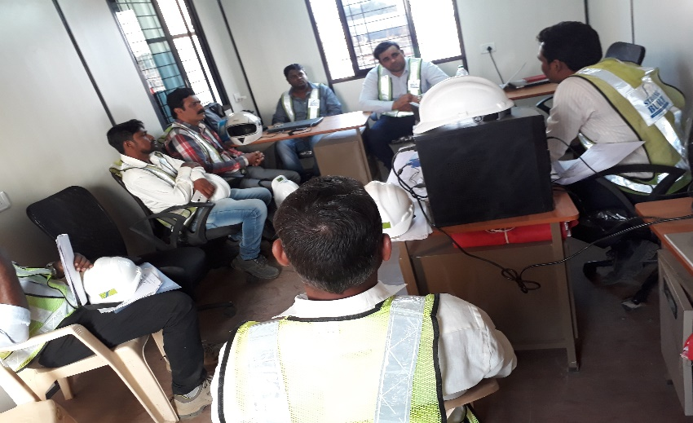
Quality Management System Training & Induction
QMS & HSE TRAINING

Slide 13
Quality Management System Training & Induction
QMS & HSE TRAINING

Slide 14
Corporate Procedures-Quality (cont..)
SBT-QAM-PR-008 –Monitor of Customer Satisfaction
This procedure describes the process of gathering and monitoring the Client’s perception on quality aspects to ensure SBT deliver the project that meet Client’s expectation.
The Quality Representative is responsible to ensure the effectiveness of the process and to maintain a good working relationship with Client to ensure Client’s addressed issues are properly close out in timely manner.
The Project Quality Representative shall implement the Client Satisfaction Survey at 50% and 100% of project completion.

Slide 15
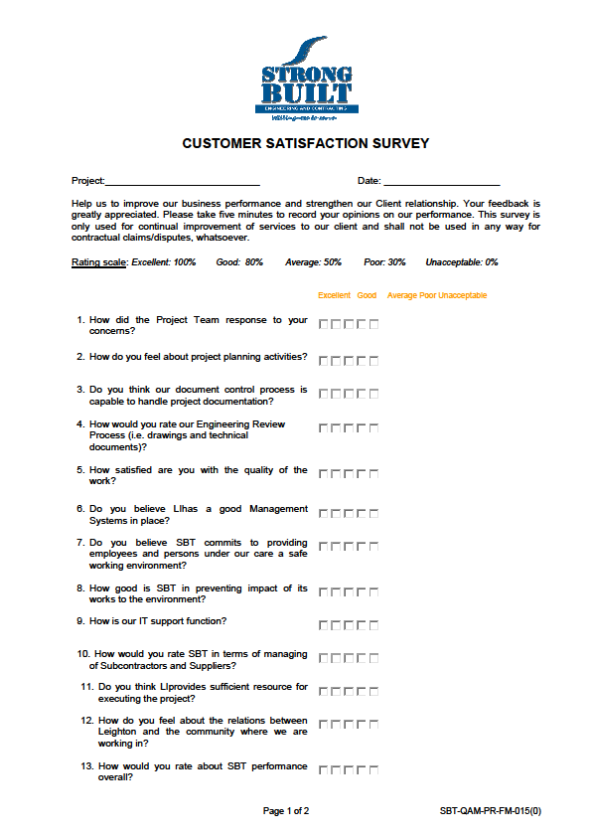
Customer satisfaction survey form

Slide 16
Corporate Procedures-Quality (cont..)
SBT-QAM-PR-009 –Quality Awards
This procedure sets out the Quality Award Processes to be adopted at SBT. This procedure explains about the criterions, categories of awards, selection methodology and frequency for such awards.
The Quality Awards Programmed is designed to recognize and reward the individuals/ project teams who have excelled in their performance in regards of quality aspect. The rewarded individuals/ projects are set as the role models to cultivate the quality culture within the organization..

Slide 17
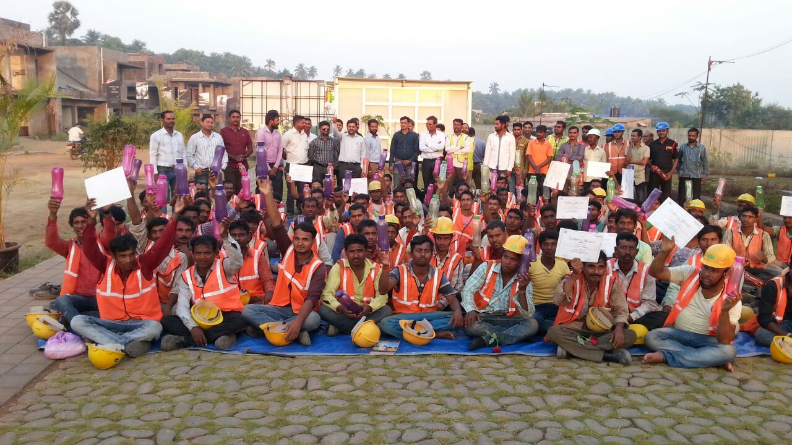
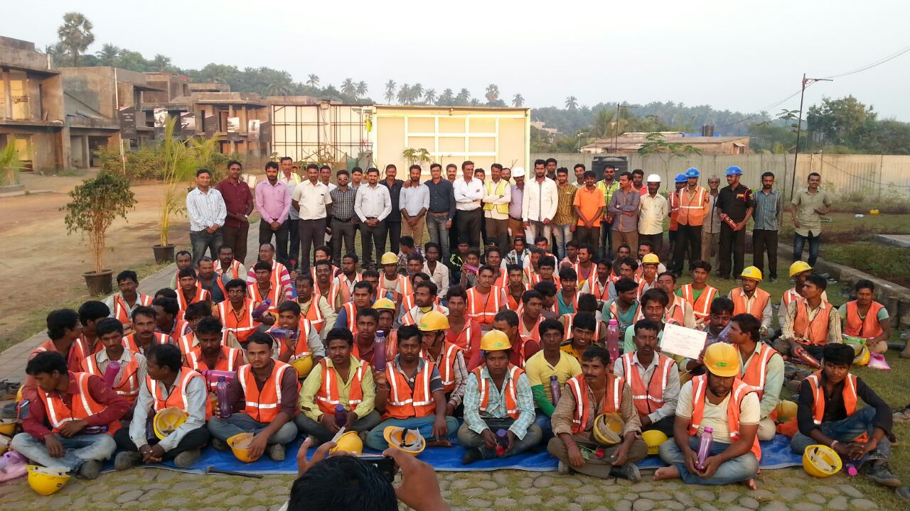

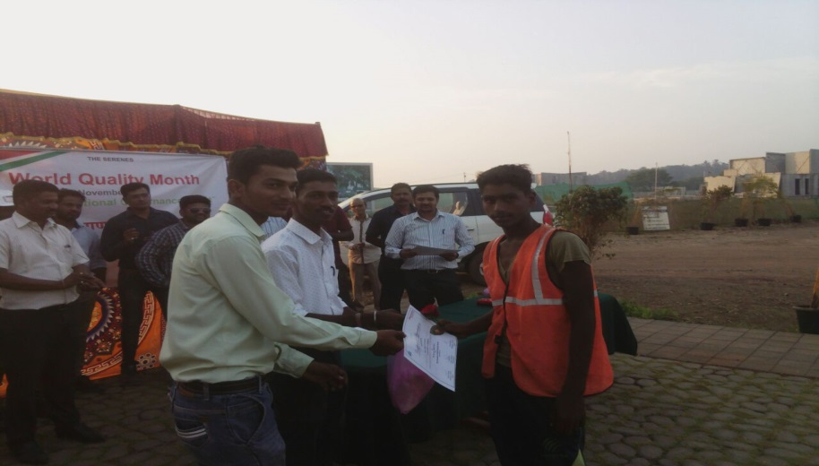
Quality Award
Quality Award Distribution At Mahindra Project

Slide 18
Quality System Documents
Plans
Procedures
Construction Method Statements
Standard Operating Procedures
Inspection & Test Plans (ITP)
Records (Checklists, As Builts, Test Reports)

Slide 19
Quality Initiatives
Quality Walks
Quality Walk Closeout Report
Quality Pocket Card
Idiot Guide for Quality
Quality Control Training

Slide 20
Quality Initiatives
Quality Walks
The Project Quality Manager shall decide the frequency of “Quality Walks”. He shall notify the concerned person (supervisor, project engineer, quality engineer, project manager, sub-contractor’s engineer, client’s representative, if any) one week prior to such walks.
The non conformities which are already raised in the form of Non-Conformance Report shall not be raised in such walks.

Slide 21
Quality Walk Report

Slide 22
Quality Walk Closeout Report

Slide 23
Quality Initiatives
Pocket Cards
The Quality Pocket Cards are the pocket sized cards which project persons can carry and refer in the field.
The Project QA/QC Manager shall select or approve the content of these cards e.g. Lap lengths, concrete covers required , status of calibration, grades of concrete at different levels, unit weight of steel bars, aggregate etc. These cards should be distributed to project personnel

Slide 24
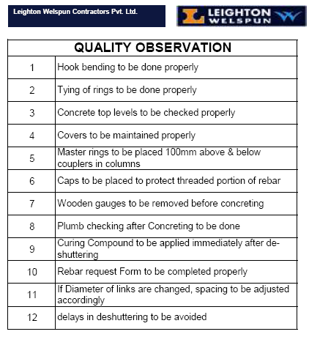
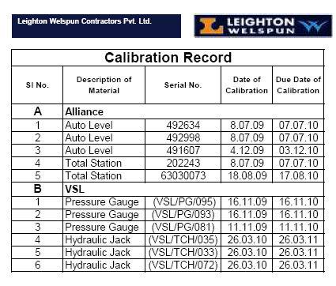
Sample Quality Pocket Cards

Slide 25

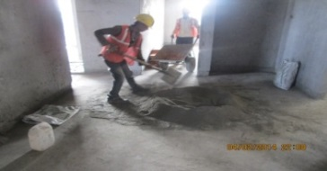
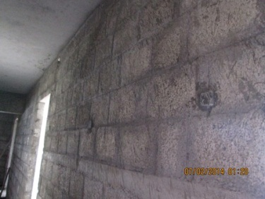

Sample Idiot Guide for Quality
IMPORTANT BLOCK/PLASTER GUIDE
S.NO | DESCRIPTION |  |  | PHOTO
1 | BLOCK WORK MIX RATIO: | 100 mm Block work | 1:4
 |  | Above 100 mm Block work | 1:6
 | PLASTERING MIX RATIO: | Wall plaster 1:4 (1:6 if ready mix)
 |  | Ceiling plaster | 1:3
 |  | Chasing filling | 1:3
 |  | Fiber mesh fixing | 1:3
2 | PLASTER THICKNESS | Ceiling | 10mm
 |  | Inner wall | 12mm
 |  | External wall | 20mm
 |  | Block Bed mortar(Block around) | 12mm
3 | Fix fiber mesh over Conduits and blocks & concrete joints

Slide 26
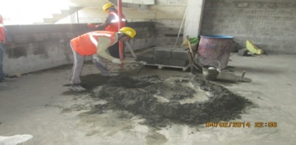
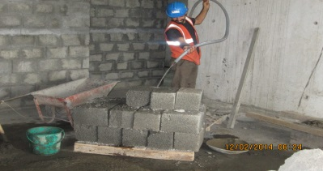
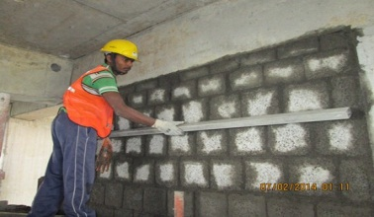
Sample Idiot Guide for Quality
S.NO | DESCRIPTION |  |  | PHOTO
4 | Mix mortar Quantity for 2 hours requirement only
5 | Wet the blocks with water prior to use. | ͦͦ
6 | Use straight edges and line thread to maintain line & level.

Slide 27




Sample Idiot Guide for Quality
S.NO | DESCRIPTION |  |  | PHOTO
7 | Maintain straight and clean interface between wall & ceiling joints.
8 | Reuse the falling mortar within 1 hour
9 | Plaster construction joints should be 90 degree.
10 | Write date on the wall and do the curing for the 7 days.

Slide 28
Sample Idiot Guide for Quality
S.NO | DESCRIPTION |  |  | PHOTO
7 | Maintain straight and clean interface between wall & ceiling joints.
8 | Reuse the falling mortar within 1 hour
9 | Plaster construction joints should be 90 degree.
10 | Write date on the wall and do the curing for the 7 days.

Slide 29
THANKS FOR YOUR VALUABLE TIME

